Slide 1
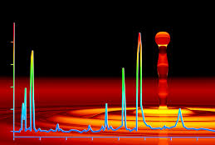
High Performance Liquid Chromatography
(HPLC)

Slide 2
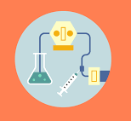
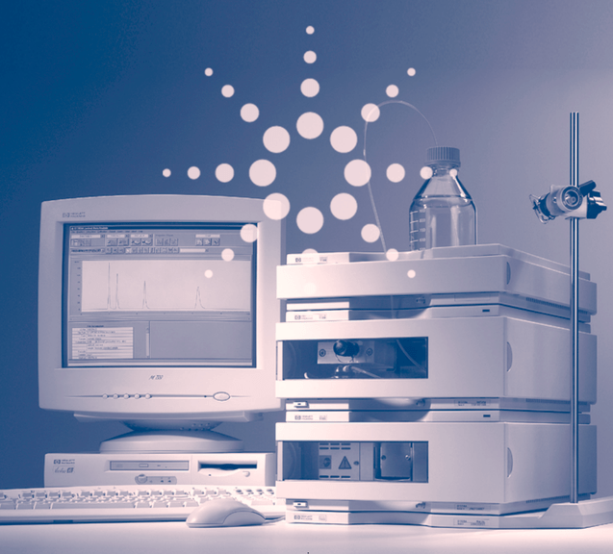
Introduction to HPLC
** This presentation contains GIFs – animations that show the difference between Normal phase and Reverse phase. What in full screen mode for full effect **

Slide 3
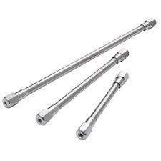
Introduction to HPLC
High Performance Liquid Chromatography or HPLC
HPLC can be used for compounds that do not easily vaporise or decompose when heated
HPLC operated at room temperature
Mobile phase: liquid or solution
Stationary phase: Silicon dioxide (SiO₂), tightly packed into a metal column (3-5 mm diameter, 10-30 cm length)
Separation property: Polarity
HPLC columns, various lengths

Slide 4
Introduction to HPLC
Small particle size of the stationary phase results in a large surface area and therefore greater interactions between the analytes in the mobile phase
However, this reduces the flow rate of the mobile phase through the column – we use a high-pressure pump force the liquid through the column at an increased rate
Two Types of HPLC:
    Normal Phase
    Reverse Phase

Slide 5
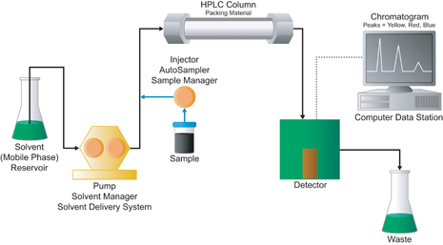
The instrument
The sample is injected via an injection loop
The mobile phase (a liquid) is forced through the column using a pump
Once the analytes have been injected, they travel through the column at different rates, separating based on their polarity.
The separated analytes pass though a detector and the signal sent to a computer which creates a Chromatogram

Slide 6
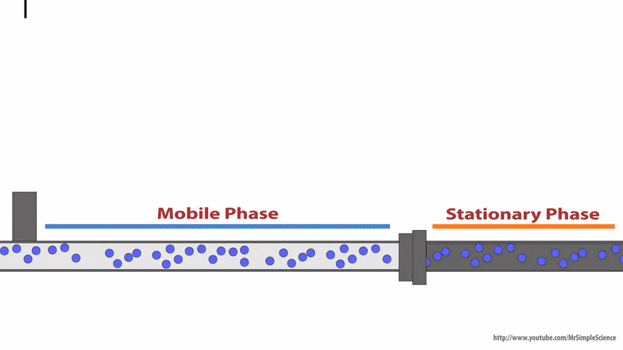
The instrument
Injecting the sample

Slide 7
Normal phase vs Reverse Phase HPLC
Two types of HPLC – Normal phase and Reverse Phase
Normal Phase | Reverse Phase
Mobile phase: non-polar solvent (e.g. hexane) Stationary phase: polar silicon dioxide Retention time: Non-polar analytes interact more strongly with the Non-polar mobile phase, so they travel faster and have a shorter Rt Polar analytes interact more strongly with the Polar stationary phase, slowing their movement and resulting in longer Rt | Mobile phase: polar solvent (e.g. water) Stationary phase: Non-polar (silicon dioxide coated in long hydrocarbon chains) Retention time: Non-polar analytes interact more strongly with the Non-polar stationary phase, so they travel slower and have a longer Rt Polar analytes interact more strongly with the Polar mobile phase, so they travel faster and resulting in shorter Rt

Slide 8
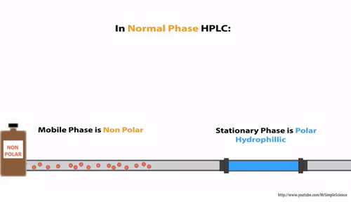
Normal Phase HPLC

Slide 9
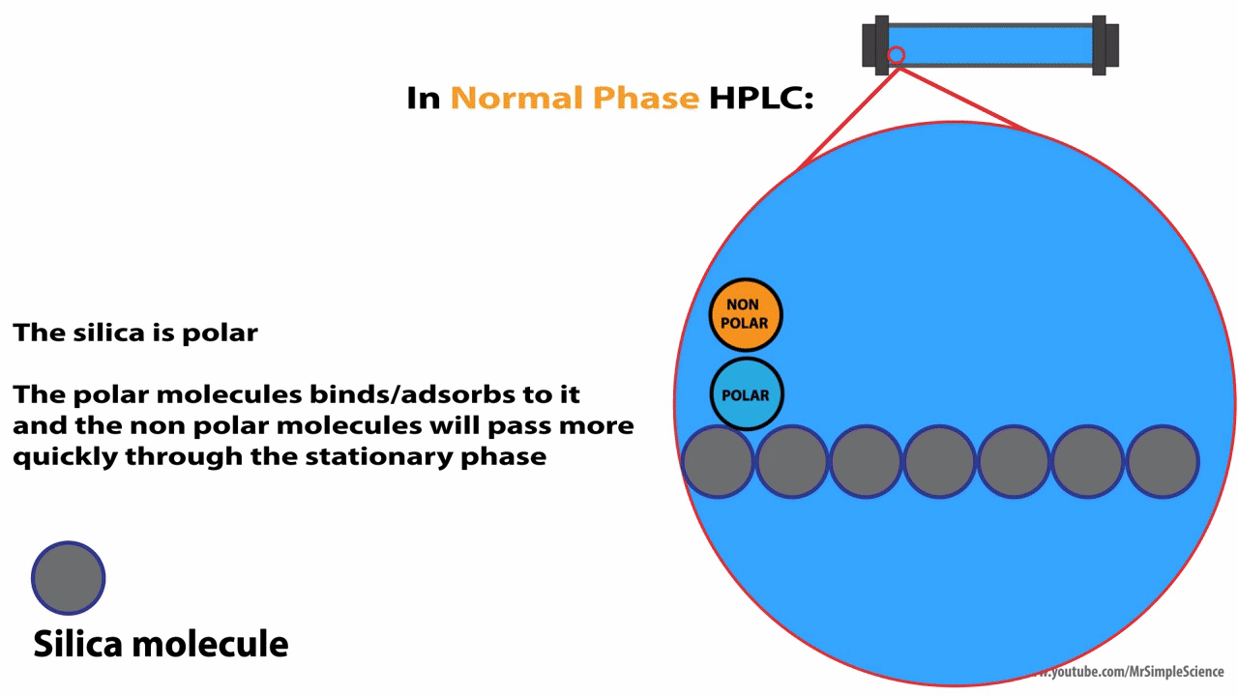
Normal Phase HPLC

Slide 10
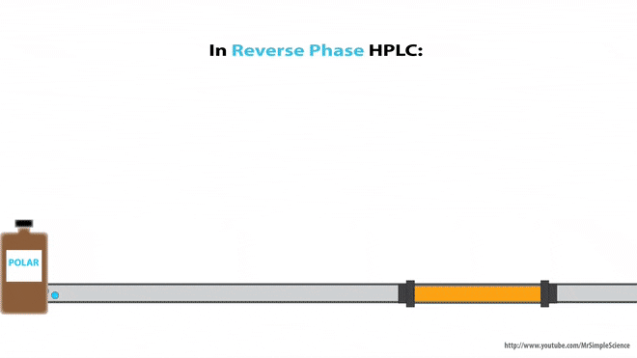
Reverse Phase HPLC

Slide 11
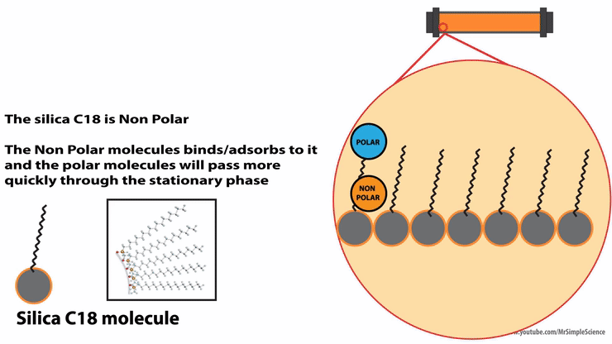
Reverse Phase HPLC

Slide 12
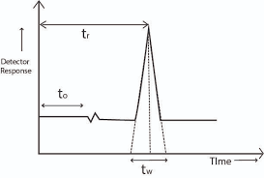
Detectors
Typically a UV/Vis Detector is used (UV = ultra violet light and Vis = visible light)
Any compound that absorbs UV or Visible light will be detected
Signals time and detector response are recorded by a computer and graphed to create a Chromatogram

Slide 13
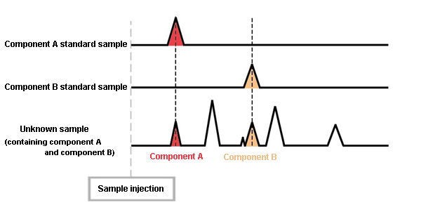
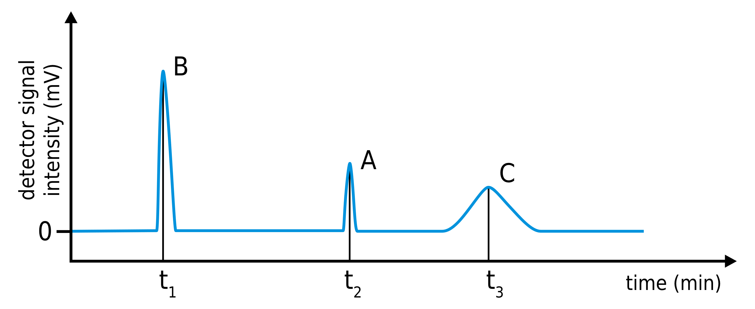
Detectors
Remember – Rt can provide evidence to identify the analyte
Remember – if you want to relate concentration of analyte to peak area (or peak height) you need to construct a calibration curve using pure samples of the compound at known concentrations

